Slide 1
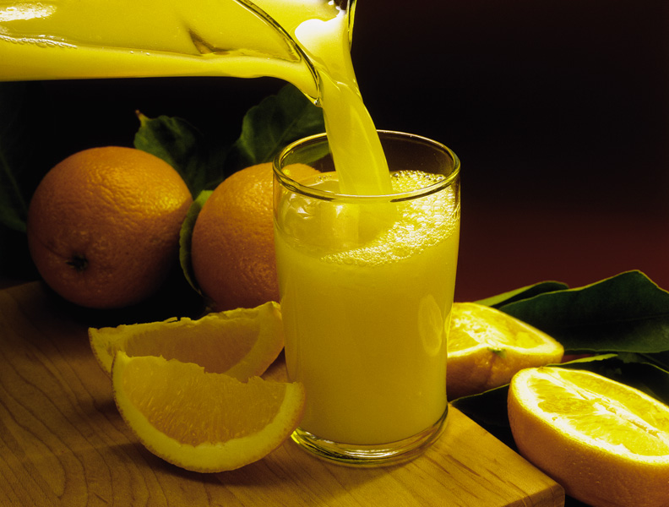
Chapter 17: Acids and Bases
General Chemistry
Principles and Modern Applications
Petrucci • Harwood • Herring
8th Edition
Philip Dutton
University of Windsor, Canada
N9B 3P4
Prentice-Hall © 2002

Slide 2
Contents
17-1 The Arrhenius Theory: A Brief Review
17-2 Brønsted-Lowry Theory of Acids and Bases
17-3 The Self-Ionization of Water and the pH Scale
17-4 Strong Acids and Strong Bases
17-5 Weak Acids and Weak Bases
17-6 Polyprotic Acids
17-7 Ions as Acids and Bases
17-8 Molecular Structure and Acid-Base Behavior
17-8 Lewis Acids and Bases
Focus On Acid Rain.

Slide 3
17-1 The Arrhenius Theory:
A Brief Review
H₂O
HCl(g) → H⁺(aq) + Cl⁻(aq)
H₂O
NaOH(s) → Na⁺(aq) + OH⁻(aq)
Na⁺(aq) + OH⁻(aq) + H⁺(aq) + Cl⁻(aq) → H₂O(l) + Na⁺(aq) + Cl⁻(aq)
H⁺(aq) + OH⁻(aq) → H₂O(l)
Arrhenius theory did not handle non OH⁻ bases such as ammonia very well.
Notes:
Arrhenius proposed that in an aqueous electrolyte solution, a strong electrolyte exists only in the form of ions, whereas a weak electrolyte exists partly as ions and partly as molecules.
The essential idea of Arrhenius theory is that a neutralization reaction involves the combination of hydrogen ions and hydroxide ions to form water.

Slide 4
17-2 Brønsted-Lowry Theory of
Acids and Bases
An acid is a proton donor.
A base is a proton acceptor.
conjugate acid
conjugate base
base
acid
NH₃ + H₂O  NH₄⁺ + OH⁻
NH₄⁺ + OH⁻  NH₃ + H₂O
acid
base

Slide 5
Base Ionization Constant
conjugate
acid
conjugate
base
base
acid
NH₃ + H₂O  NH₄⁺ + OH⁻
[NH₄⁺][OH⁻]
K_{c}=
[NH₃][H₂O]
[NH₄⁺][OH⁻]
K_{b}= K_{c}[H₂O] =
= 1.810⁻⁵
[NH₃]

Slide 6
Acid Ionization Constant
conjugate
base
conjugate
acid
acid
base
CH₃CO₂H + H₂O  CH₃CO₂⁻ + H₃O⁺
[CH₃CO₂⁻][H₃O⁺]
K_{c}=
[CH₃CO₂H][H₂O]
[CH₃CO₂⁻][H₃O⁺]
K_{a}= K_{c}[H₂O] =
= 1.810⁻⁵
[CH₃CO₂H]

Slide 7
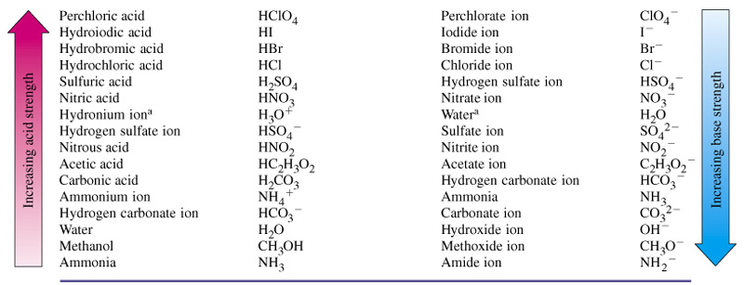
Table 17.1 Relative Strengths of Some Brønsted-Lowry Acids and Bases
HCl + OH⁻  Cl⁻ + H₂O
NH₄⁺ + CO₃²⁻  NH₃ + HCO₃⁻
HClO₄ + H₂O  ClO₄⁻ + H₃O⁺
H₂O + I⁻  OH⁻ + HI
H₂O + I⁻  OH⁻ + HI

Slide 8
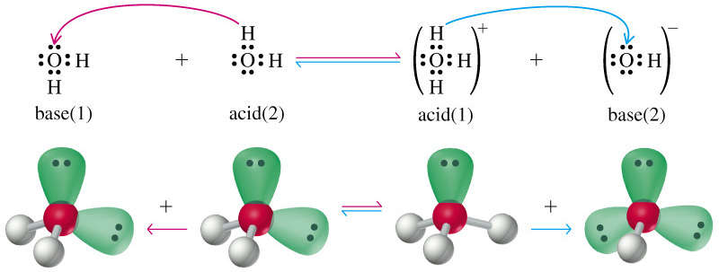
17-3 The Self-Ionization of Water and the pH Scale

Slide 9
Ion Product of Water
conjugate
acid
conjugate
base
base
acid
H₂O + H₂O  H₃O⁺ + OH⁻
[H₃O⁺][OH⁻]
K_{c}=
[H₂O][H₂O]
K_{W}= K_{c}[H₂O][H₂O] =
[H₃O⁺][OH⁻]
= 1.010⁻¹⁴

Slide 10
pH and pOH
The potential of the hydrogen ion was defined in 1909 as the negative of the logarithm of [H⁺].
pH = -log[H₃O⁺]
pOH = -log[OH⁻]
K_{W} = [H₃O⁺][OH⁻]= 1.010⁻¹⁴
-logK_{W} = -log[H₃O⁺]-log[OH⁻]= -log(1.010⁻¹⁴)
pK_{W} = pH + pOH= -(-14)
pK_{W} = pH + pOH = 14

Slide 11
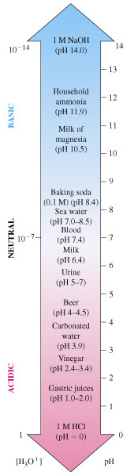
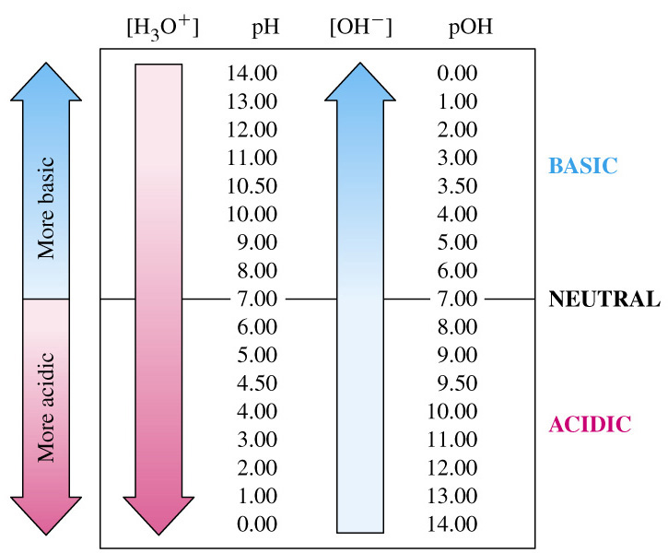
pH and pOH Scales

Slide 12
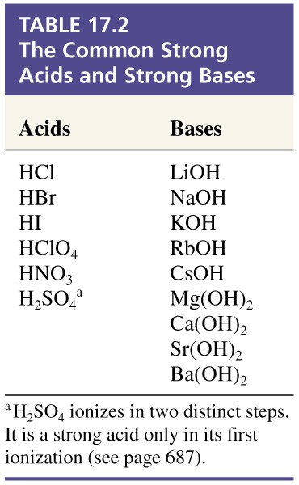
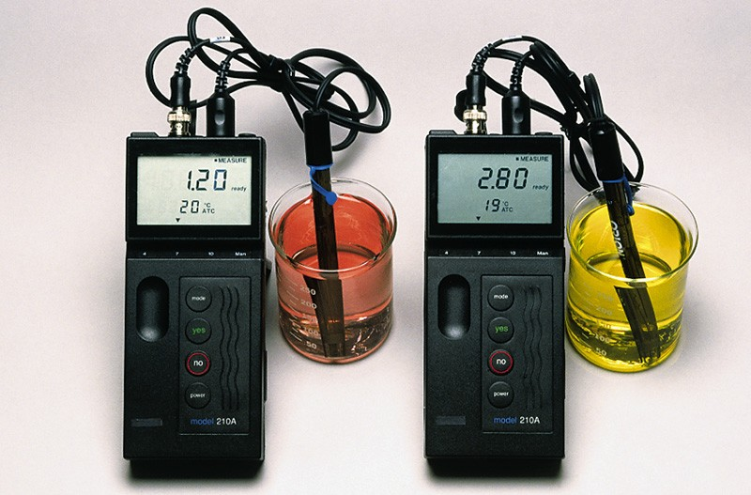
17-4 Strong Acids and Bases
HCl CH₃CO₂H
Thymol Blue Indicator
pH < 1.2 < pH < 2.8 < pH

Slide 13
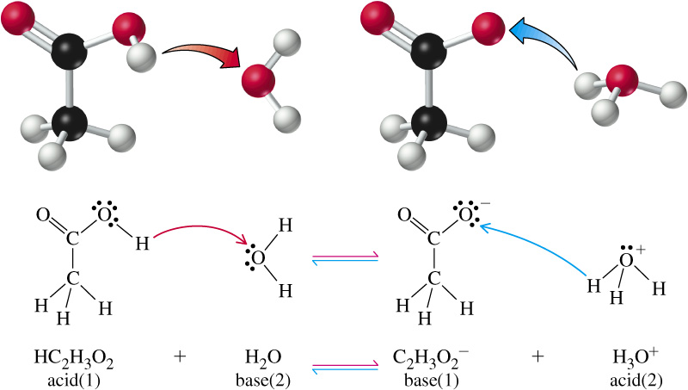
17-5 Weak Acids and Bases
Acetic Acid
HC₂H₃O₂ or CH₃CO₂H

Slide 14
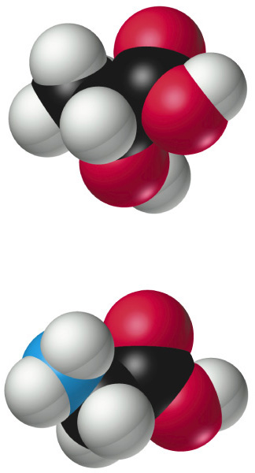
Weak Acids
[CH₃CO₂⁻][H₃O⁺]
K_{a}=
= 1.810⁻⁵
[CH₃CO₂H]
pK_{a}= -log(1.810⁻⁵) = 4.74
O
lactic acid CH₃CH(OH) CO₂H
R
C
glycine H₂NCH₂CO₂H
OH

Slide 15
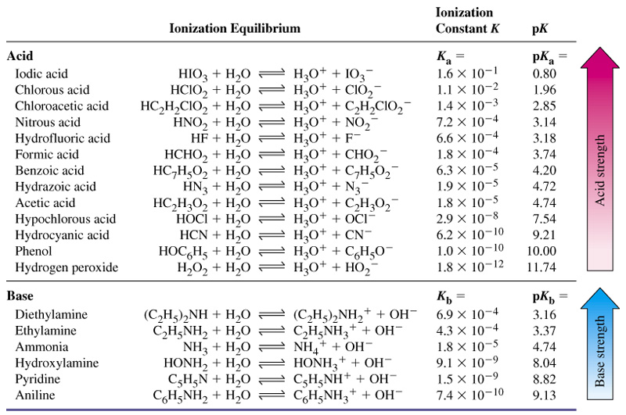
Table 17.3 Ionization Constants of Weak Acids and Bases

Slide 16
Example 17-5
Determining a Value of K_{A} from the pH of a Solution of a Weak Acid.
Butyric acid, HC₄H₇O₂ (or CH₃CH₂CH₂CO₂H) is used to make compounds employed in artificial flavorings and syrups. A 0.250 M aqueous solution of HC₄H₇O₂ is found to have a pH of 2.72. Determine K_{A} for butyric acid.
HC₄H₇O₂ + H₂O  C₄H₇₇O₂ + H₃O⁺ K_{a} = ?
Solution:
For HC₄H₇O₂ K_{A} is likely to be much larger than K_{W}. Therefore assume self-ionization of water is unimportant.

Slide 17
Example 17-5
HC₄H₇O₂ + H₂O  C₄H₇O₂ + H₃O⁺
Initial conc. 0.250 M 0 0
Changes -x M +x M +x M
Eqlbrm conc. (0.250-x) M x M x M
Notes:
Treat the situation as if HC4H7O2 first dissolves in molecular form and then the molecules ionize until equilibrium is reached. Represent the concentrations of C4H7O2- and H3O+ at equilibrium as x.

Slide 18
Example 17-5
HC₄H₇O₂ + H₂O  C₄H₇₇O₂ + H₃O⁺
Log[H₃O⁺] = -pH = -2.72
[H₃O⁺] = 10^{-2.72} = 1.910⁻³ = x
[H₃O⁺] [C₄H₇O₂⁻]
1.910⁻³ · 1.910⁻³
K_{a}=
=
[HC₄H₇O₂]
(0.250 – 1.910⁻³)
K_{a}= 1.510⁻⁵
Check assumption: K_{a} >> K_{W}.
Notes:
But x is not known. It is the concentration of H3O+ in solution from which we can determine the pH.

Slide 19
Percent Ionization
HA + H₂O  H₃O⁺ + A⁻
[H₃O⁺] from HA
Degree of ionization =
[HA] originally
[H₃O⁺] from HA
Percent ionization =
 100%
[HA] originally

Slide 20
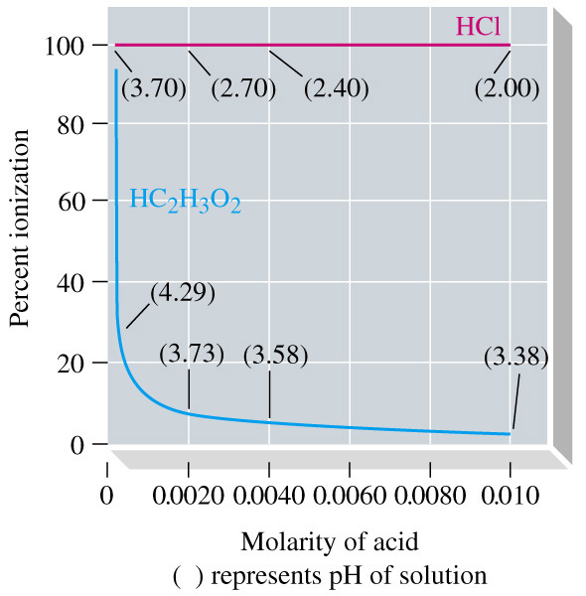
Percent Ionization
[H₃O⁺][A⁻]
K_{a} =
[HA]
n
n
1
K_{a} =
H₃O⁺
A⁻
n
V
HA

Slide 21
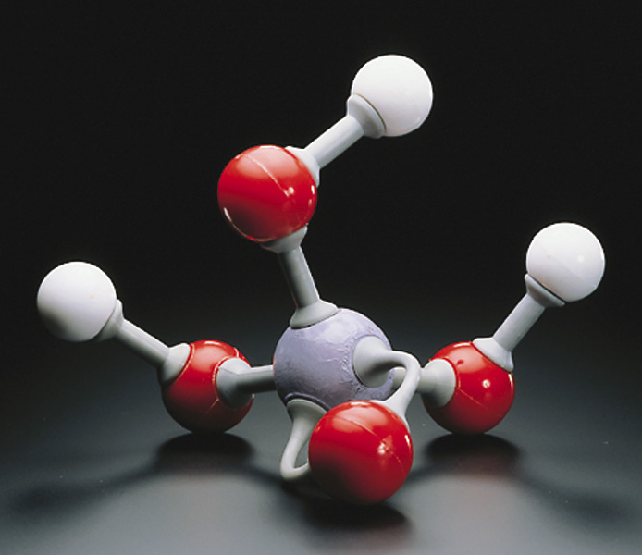
17-6 Polyprotic Acids
Phosphoric acid:
A triprotic acid.
H₃PO₄ + H₂O  H₃O⁺ + H₂PO₄⁻
K_{a} = 7.110⁻³
H₂PO₄⁻ + H₂O  H₃O⁺ + HPO₄²⁻
K_{a} = 6.310⁻⁸
HPO₄²⁻ + H₂O  H₃O⁺ + PO₄³⁻
K_{a} = 4.210⁻¹³

Slide 22
Phosphoric Acid
K_{a1} >> K_{a2}
    All H₃O⁺ is formed in the first ionization step.
H₂PO₄⁻ essentially does not ionize further.
    Assume [H₂PO₄⁻] = [H₃O⁺].
[HPO₄²⁻] K_{a2} regardless of solution molarity.

Slide 23
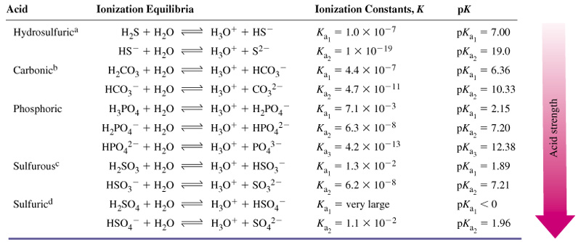
Table 17.4 Ionization Constants of Some Polyprotic Acids

Slide 24
Example 17-9
Calculating Ion Concentrations in a Polyprotic Acid Solution.
For a 3.0 M H₃PO₄ solution, calculate:
(a) [H₃O⁺]; (b) [H₂PO₄⁻]; (c) [HPO₄²⁻] (d) [PO₄³⁻]
H₃PO₄ + H₂O  H₂PO₄⁻ + H₃O⁺
Initial conc. 3.0 M 0 0
Changes -x M +x M +x M
Eqlbrm conc. (3.0-x) M x M x M

Slide 25
Example 17-9
H₃PO₄ + H₂O  H₂PO₄⁻ + H₃O⁺
[H₃O⁺] [H₂PO₄⁻]
x · x
K_{a}=
=
= 7.110⁻³
[H₃PO₄]
(3.0 – x)
Assume that x << 3.0
x² = (3.0)(7.110⁻³) x = 0.14 M
[H₂PO₄⁻] = [H₃O⁺] = 0.14 M

Slide 26
Example 17-9
H₂PO₄⁻ + H₂O  HPO₄²⁻ + H₃O⁺
Initial conc. 0.14 M 0 0.14 M
Changes -y M +y M +y M
Eqlbrm conc. (0.14 - y) M y M (0.14 +y) M
[H₃O⁺] [HPO₄²⁻]
y · (0.14 + y)
K_{a}=
=
= 6.310⁻⁸
[H₂PO₄⁻]
(0.14 - y)
y << 0.14 M y = [HPO₄²⁻] = 6.310⁻⁸

Slide 27
Example 17-9
HPO₄⁻ + H₂O  PO₄³⁻ + H₃O⁺
[H₃O⁺] [HPO₄²⁻]
(0.14)[PO₄³⁻]
K_{a}=
=
= 4.210⁻¹³ M
[H₂PO₄⁻]
6.310⁻⁸
[PO₄³⁻] = 1.910⁻¹⁹ M

Slide 28
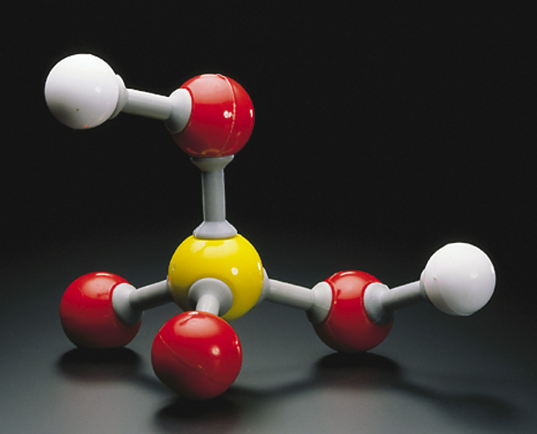
Sulfuric Acid
Sulfuric acid:
A diprotic acid.
H₂SO₄ + H₂O  H₃O⁺ + HSO₄⁻
K_{a} = very large
HSO₄⁻ + H₂O  H₃O⁺ + SO₄²⁻
K_{a} = 1.96

Slide 29
General Approach to Solution Equilibrium Calculations
Identify species present in any significant amounts in solution (excluding H₂O).
Write equations that include these species.
  Number of equations = number of unknowns.
    Equilibrium constant expressions.
    Material balance equations.
    Electroneutrality condition.
Solve the system of equations for the unknowns.

Slide 30
17-7 Ions as Acids and Bases
CH₃CO₂⁻ + H₂O  CH₃CO₂H + OH⁻
base
acid
[NH₃] [H₃O⁺]
NH₄⁺ + H₂O  NH₃ + H₃O⁺
K_{a}=
= ?
[NH₄⁺]
acid
base
[NH₃] [H₃O⁺] [OH⁻]
K_{W}
1.010⁻¹⁴
K_{a}=
=
=
= 5.610⁻¹⁰
[NH₄⁺] [OH⁻]
K_{b}
1.810⁻⁵
K_{a} K_{b} = K_{w}

Slide 31
Hydrolysis
Water (hydro) causing cleavage (lysis) of a bond.
Na⁺ + H₂O → Na⁺ + H₂O
No reaction
Cl⁻ + H₂O → Cl⁻ + H₂O
No reaction
NH₄⁺ + H₂O → NH₃ + H₃O⁺
Hydrolysis

Slide 32
17-8 Molecular Structure and
Acid-Base Behavior
Why is HCl a strong acid, but HF is a weak one?
Why is CH₃CO₂H a stronger acid than CH₃CH₂OH?
There is a relationship between molecular structure and acid strength.
Bond dissociation energies are measured in the gas phase and not in solution.

Slide 33
Strengths of Binary Acids
HI HBr HCl HF
Bond length
160.9 > 141.4 > 127.4 > 91.7 pm
Bond energy
297 < 368 < 431 < 569 kJ/mol
Acid strength
10⁹ > 10⁸ > 1.310⁶ >> 6.610⁻⁴
HF + H₂O → [F⁻·····H₃O⁺]  F⁻ + H₃O⁺
ion pair
H-bonding
free ions
Notes:
HF Anomalous behavior due to
Hydogen bonding?
Ion pairing?
These are the arguments for it

Slide 34
Strengths of Oxoacids
Factors promoting electron withdrawal from the OH bond to the oxygen atom:
  High electronegativity (EN) of the central atom.
  A large number of terminal O atoms in the molecule.
H-O-Cl H-O-Br
EN_{Cl} = 3.0 EN_{Br}= 2.8
K_{a} = 2.910⁻⁸ K_{a} = 2.110⁻⁹

Slide 35
O
··
O
··
··
··
··
··
··
··
H
O
S
O
H
H
O
S
O
H
··
··
··
··
··
O
··
··
K_{a} 10³ K_{a} =1.310⁻²
··
-
··
-
O
··
O
··
··
··
··
2+
··
··
+
··
H
O
S
O
H
H
O
S
O
H
··
··
··
··
··
-
O
··
··
··

Slide 36
Strengths of Organic Acids
··
O
H
··
H
H
··
··
H
C
C
O
H
H
C
C
O
H
··
··
H
H
H
acetic acid ethanol
K_{a} = 1.810⁻⁵ K_{a} =1.310⁻¹⁶

Slide 37
Focus on the Anions Formed
H
H
··
-
H
C
C
O
··
··
H
H
H
··
··
··
-
O
H
O
··
··
H
C
C
H
C
C
-
··
··
O
O
H
··
··
H
··

Slide 38
Structural Effects
H
··
O
··
C
K_{a} = 1.810⁻⁵
K_{a} = 1.310⁻⁵
H
C
-
··
O
H
··
··
H
H
H
H
H
H
H
··
O
··
H
C
C
C
C
C
C
C
C
-
··
H
H
H
H
H
H
H
O
··
··
Notes:
Chain length does not particularly affect acid strength.

Slide 39
Structural Effects
H
··
O
··
C
K_{a} = 1.810⁻⁵
K_{a} = 1.410⁻³
H
C
-
··
O
H
··
··
Cl
··
O
··
H
C
C
-
··
O
H
··
··
Notes:
Highly electronegative chlorine atom

Slide 40
Strengths of Amines as Bases
H
H
H
N
··
Br
N
··
H
H
ammonia bromamine
pK_{b} = 4.74 pK_{a} = 7.61

Slide 41
Strengths of Amines as Bases
H
H
H
H
H
H
H
C
NH₂
H
C
C
NH₂
H
C
C
C
NH₂
H
H
H
H
H
H
methylamine ethylamine propylamine
pK_{b} = 4.74 pK_{a} = 3.38 pK_{b} = 3.37
Notes:
Hydrocarbons are somewhat electron donating.

Slide 42
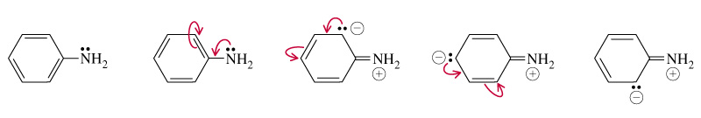
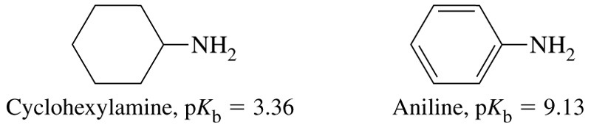
Resonance Effects

Slide 43
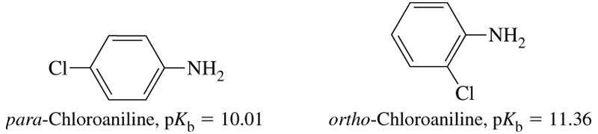
Inductive Effects

Slide 44
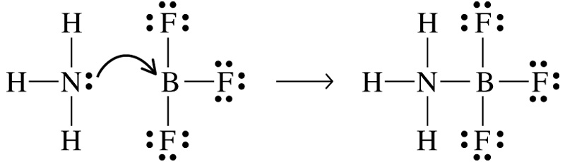
17-9 Lewis Acids and Bases
Lewis Acid
  A species (atom, ion or molecule) that is an electron pair acceptor.
Lewis Base
  A species that is an electron pair donor.
base
acid
adduct

Slide 45
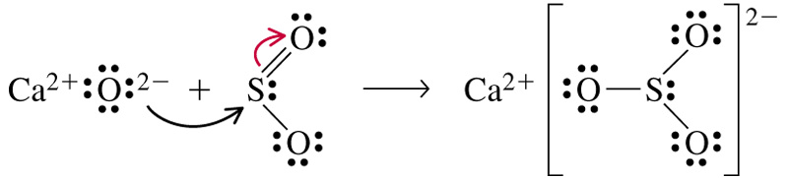
Showing Electron Movement

Slide 46
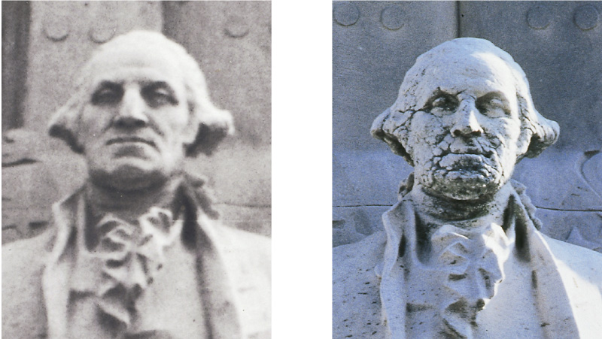
Focus On Acid Rain
CO₂ + H₂O  H₂CO₃
H₂CO₃ + H₂O  HCO₃⁻ + H₃O⁺
3 NO₂ + H₂O  2 HNO₃ + NO

Slide 47
Chapter 17 Questions
Develop problem solving skills and base your strategy not on solutions to specific problems but on understanding.
Choose a variety of problems from the text as examples.
Practice good techniques and get coaching from people who have been here before.

